Slide 1
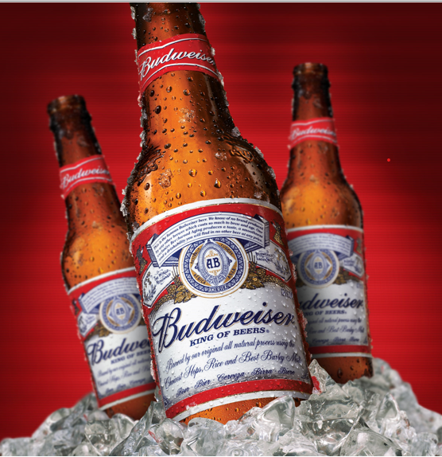
Beer Case Study
Halle Purdom and Nnenna Okpara

Slide 2
Analysis Questions
How many breweries are present in each state?
Why are there missing values?
What is the median ABV and IBU for each state?
Which state has the highest ABV and which state has the highest IBU values?
Comment on the Summary statistics and distribution of ABV.
Is there a relationship between the bitterness of the beer and its alcoholic content? Draw a scatter plot
Is there a difference between IPA’s and Ale’s?
Useful inference from the data for the Budweiser brand.

Slide 3
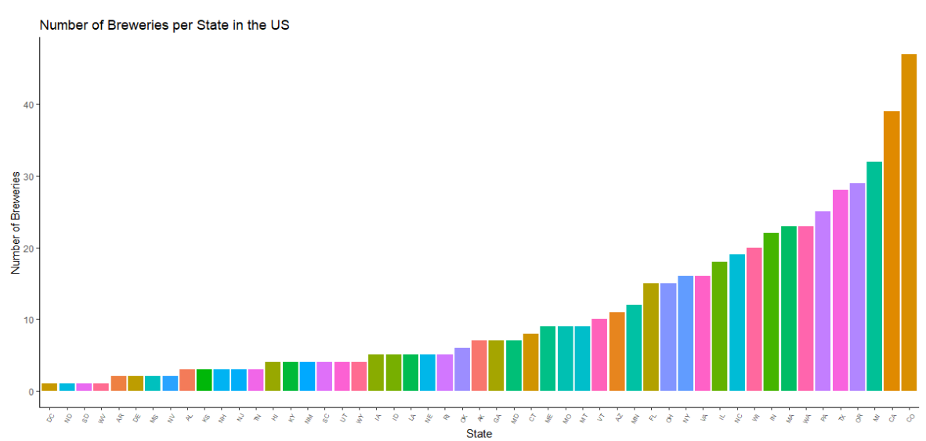
Number of Breweries by state in the US
Top 10 States by Brewery
Colorado - 47
California - 39
Michigan - 32
Oregon - 29
Texas - 28
Pennsylvania - 25
Washington -23
Massachusetts - 23
Indiana - 22
Wisconsin - 20

Slide 4
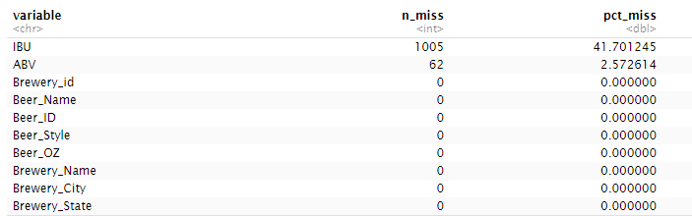
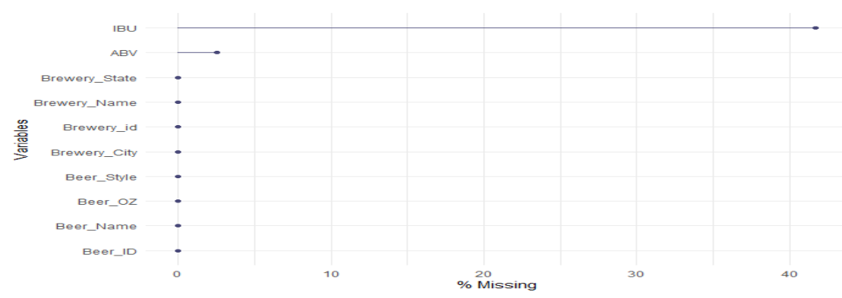
Missing values and Data Merging
Data was merged by the Brewery ID column present in the Beer and Brewery data
The table and plot shows the number of missing values (NA) in each column. There are only two variables with missing values. ABV is missing 62 values while IBU is missing 1005 values.
Missing values were filtered from the data rather than imputed to eliminate the risk of introducing potentially incorrect data into the group. Over 1005 datapoints would have to be imputed for a dataset that only has 2410 rows total (~40 percent of the data.)

Slide 5
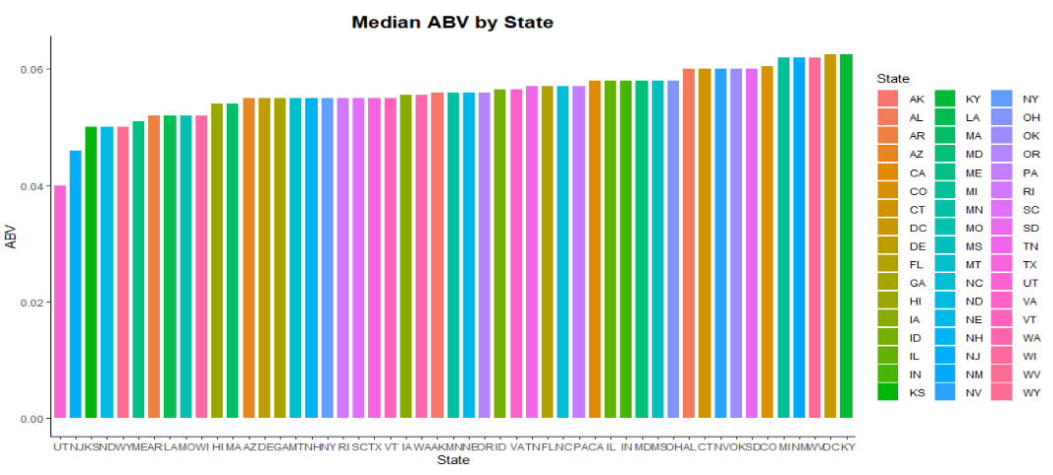
Median ABV by state
The Median Alcohol content (ABV) by State bar chart shows that Kentucky (KY) has the highest median ABV while Utah (UT) has the lowest ABV.

Slide 6
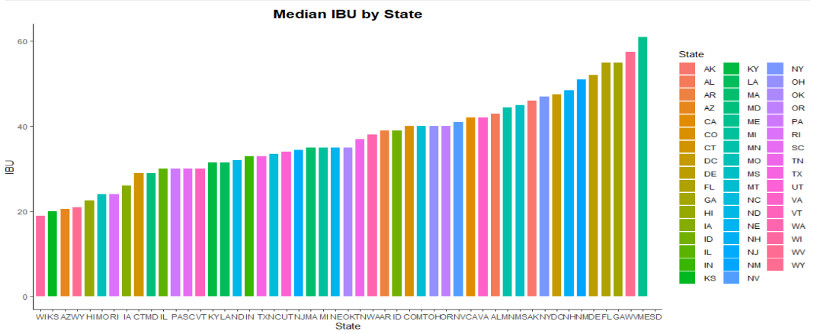
Median IBU by state
The International bitterness unit (IBU) bar chart shows that Maine (ME) has the highest median IBU value while Wisconsin (WI) has the lowest median IBU value

Slide 7
Maximum ABV and IBU
The state with the beer containing maximum alcoholic content (ABV)
Colorado: "Lee Hill Series Vol. 5 - Belgian Style Quadrupel Ale"
ABV: 0.128
Note: IBU missing from the data
The state with the most bitter (IBU) beer
Oregon: "Bitter Bitch Imperial IPA"
IBU: 138
ABV: 0.082

Slide 8
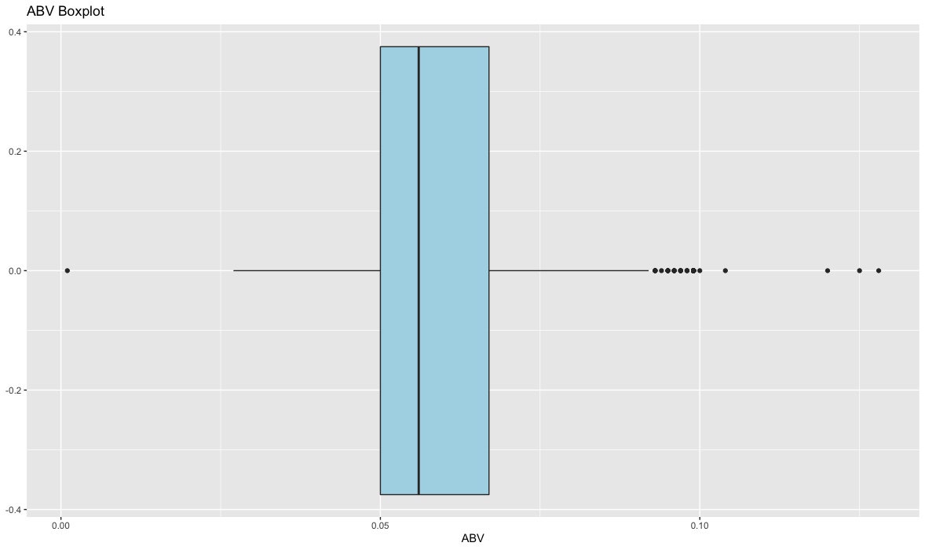
ABV Summary Statistics & Distribution
Summary Statistics
Data: n = 2348
Location
Median: 0.056
Mean: 0.060
Spread
Standard Deviation: 0.014
Shape
Close to normal distribution
Slight right skew
Boxplot of ABV Data
Median: 0.056
1st Q: 0.050
3rd Q: 0.067
Min: 0.001
Max: 0.128

Slide 9
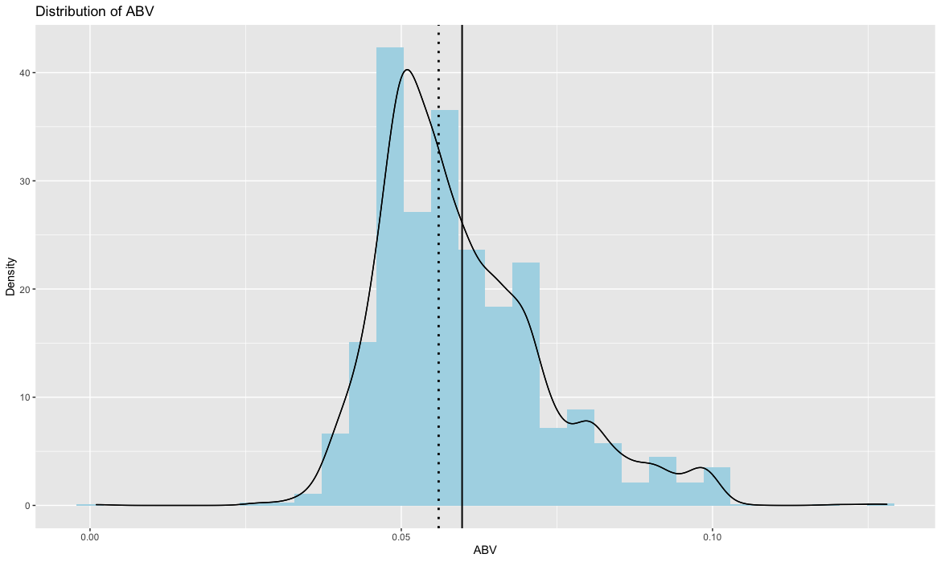

ABV Summary Statistics & Distribution
Mean: 0.060
Median: 0.056
Histogram and density plot of ABV data showing normally distributed data with a slight right skew.
Most of the beers are going to be clustered around 0.051 ABV and beers with ABV’s higher or lower than that are going to be less and less common the farther out they go from the center
The right skew means more of the beers have an ABV higher than the graph’s peak, so more beers have an ABV above 0.051 than have an ABV below 0.051

Slide 10
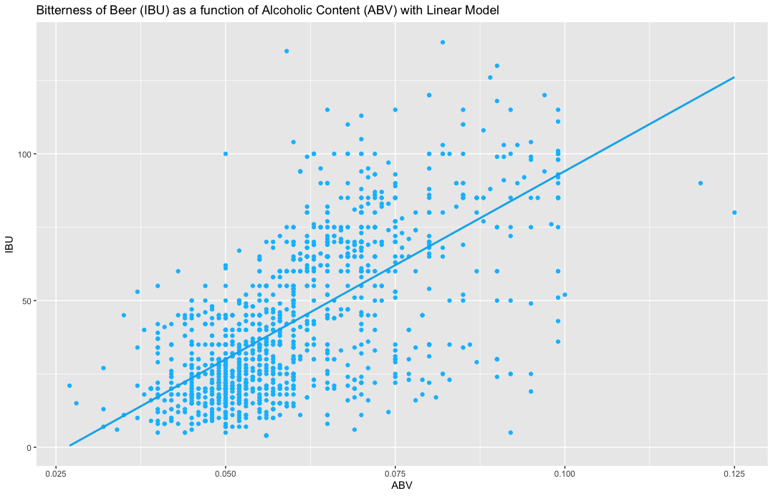
Relationship between ABV and IBU
Scatter plot and Linear Model of IBU as a function of ABV
Any beers missing ABV or IBU value were filtered from data. (n = 1405)
Based on the scatter plot and linear model of the 1,405 beers that had data for alcoholic content (ABV) and bitterness (IBU), there is an apparent positive correlation between ABV and IBU.
This could be because beers similar in ABV and IBU taste better to the consumer or because alcohol level and bitterness are dependent on each other

Slide 11
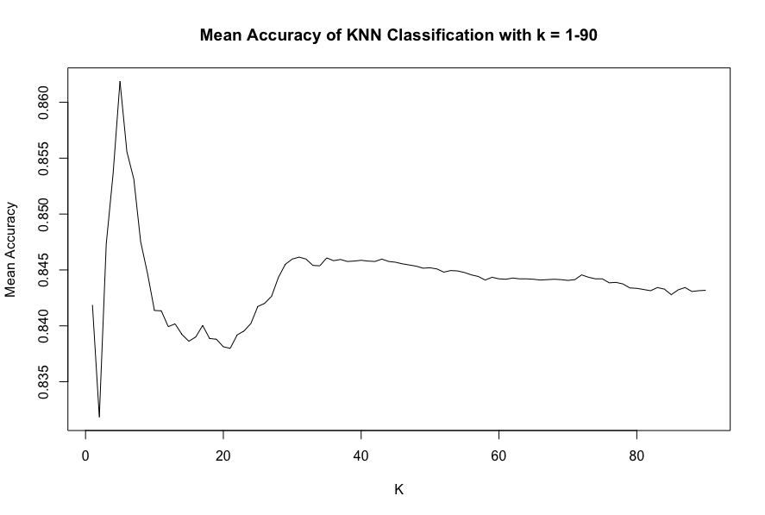
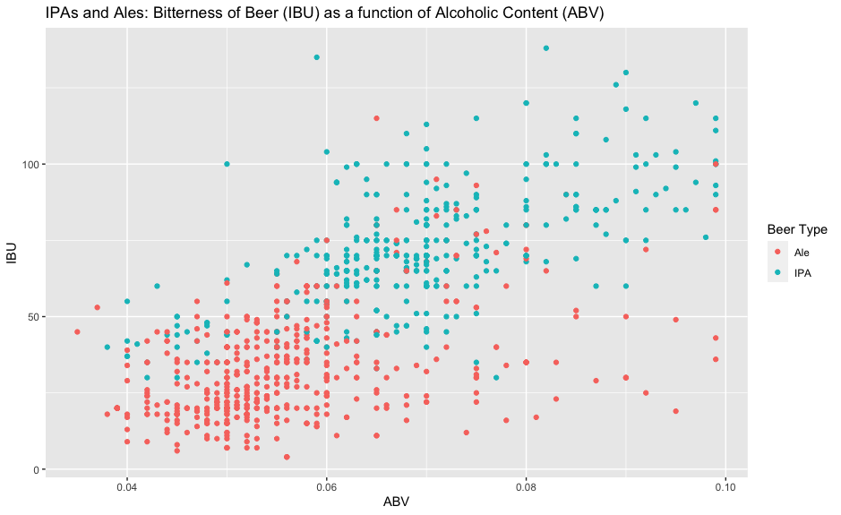
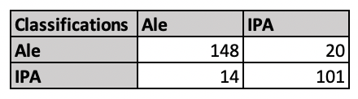
KNN Classification
Exploring IPAs and Ales relationship with respect to ABV and IBU
Most accurate k is 5
5-nn Classifier
Classifies as IPA or Ales based on ABV and IBU value
88% Accurate
91% Sensitivity
83% Specificity
Confusion Matrix:

Slide 12
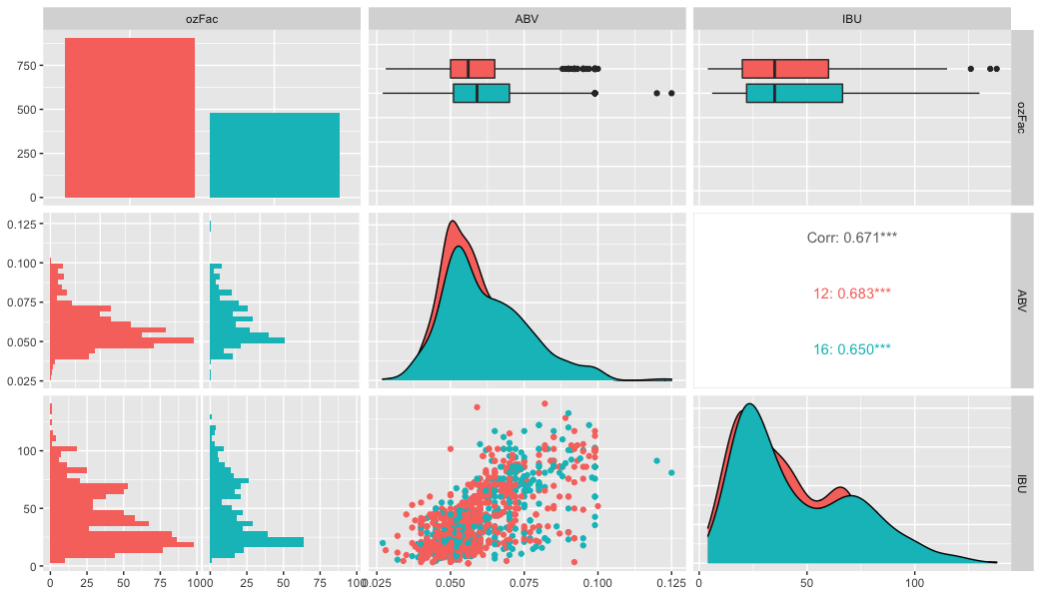
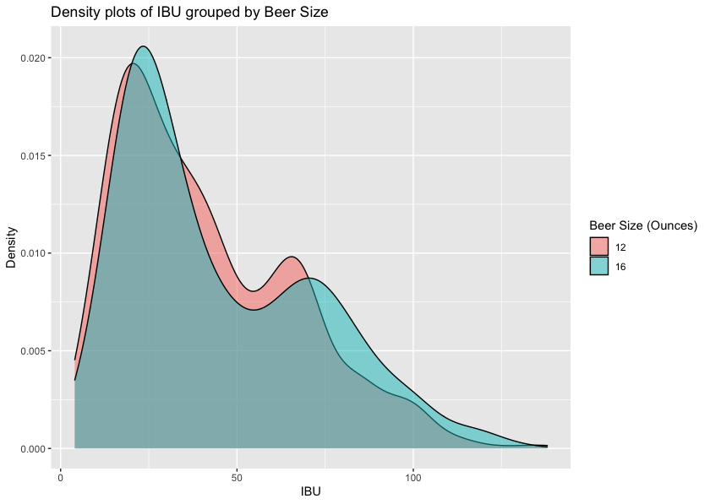
Extra Analysis
Comparing ABV and IBU data when beers are separated by size: 12 or 16 ounces
The 16-ounce beers have a distribution of ABV and IBU values slightly greater than the 12-ounce beers
The IBU variable also has a distribution with two peaks: meaning while most of the beers are clustered around 25 IBU, there is also a smaller group of beers clustered around 65 IBU.

Slide 13
Closing Remarks
In this presentation we looked at states with the highest breweries, highest median ABV and IBU values, and states with the most bitter and most alcoholic beers
In the investigation of the distribution of the ABV variable, a right skewed distribution was found meaning most beers are centered around 0.051 ABV but more can be found at higher alcohol levels than lower alcohol levels
When looking into Ales vs. IPAs, it was found that IPAs generally had higher ABVs and IBUs while Ales had lower ABVs and IBUs
In comparing 16- and 12-ounce beers, the 16-ounce beers had slightly higher distribution of alcohol levels and bitterness ratings
Lastly, the IBU variable’s distribution had a double peak, meaning while most beers had IBUs clustered around 25, another smaller group of beers also clustered around 65

Slide 14
Youtube Links
Halle Purdom
https://youtu.be/vVQMNWwsJ8Y
Nnenna Okpara
https://www.youtube.com/watch?v=oB1xGwd9zaY

